Slide 1
Unit # 6
Data Visualization using python

Slide 2
Data Visualization
Graphics provides an excellent approach for exploring the data, which is essential for presenting results.
Data visualization is a new term. It expresses the idea that involves more than just representing data in the graphical form (instead of using textual form).
This can be very helpful when discovering and getting to know a dataset and can help with classifying patterns, corrupt data, outliers, and much more.
With a little domain knowledge, data visualizations can be used to express and demonstrate key relationships in plots and charts.
The statistics does indeed focus on quantitative description and estimations of data. It provides an important set of tools for gaining a qualitative understanding.

Slide 3
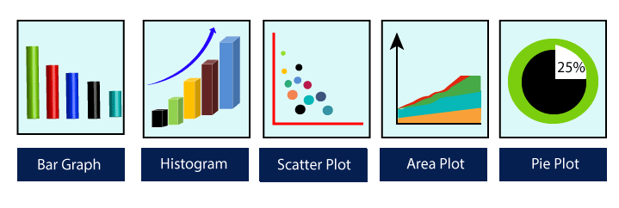
There are five key plots that are used for data visualization.

Slide 4
There are five phases which are essential to make the decision for the organization:
Visualize: We analyze the raw data, which means it makes complex data more accessible, understandable, and more usable. Tabular data representation is used where the user will look up a specific measurement, while the chart of several types is used to show patterns or relationships in the data for one or more variables.
Analysis: Data analysis is defined as cleaning, inspecting, transforming, and modeling data to derive useful information. Whenever we make a decision for the business or in daily life, is by past experience. What will happen to choose a particular decision, it is nothing but analyzing our past. That may be affected in the future, so the proper analysis is necessary for better decisions for any business or organization.
Document Insight: Document insight is the process where the useful data or information is organized in the document in the standard format.
Transform Data Set: Standard data is used to make the decision more effectively.

Slide 5
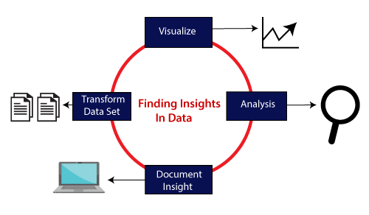
Five phases for decision making

Slide 6
Why need data visualization?
Data visualization can perform below tasks:
It identifies areas that need improvement and attention.
It clarifies the factors.
It helps to understand which product to place where.
Predict sales volumes.

Slide 7
Library vs Module
Library | Module
A library is a collection of modules or packages that provide additional functionality to Python. It can consist of multiple modules organized in a directory structure. | A module is a single Python file that contains reusable code. It can define functions, classes, and variables that can be imported and used in other Python scripts or modules.
Libraries are often created to solve specific problems or provide specialized tools for particular tasks. | Modules are a way to organize and encapsulate code for better code organization and reusability.
Examples of Python libraries include NumPy (for numerical operations), Pandas (for data manipulation), and Matplotlib (for data visualization). These libraries contain multiple modules that work together to provide comprehensive functionality. | Examples of Python modules include math.py, random.py, and os.py. You can create your own custom modules as well.

Slide 8
IDE vs Framework
IDE (Integrated Development Environment) | Framework
An IDE is a software application that provides a comprehensive development environment for programmers and developers. It typically includes a text editor for writing code, a compiler or interpreter for executing code, debugging tools, and other features to streamline the development process. | A framework is a pre-designed, reusable set of code and guidelines that provide a structured foundation for developing software applications. Frameworks define the overall architecture and provide a structure for building applications.
IDEs are highly customizable and often support multiple programming languages. They are designed to enhance productivity by providing features like code completion, syntax highlighting, project management, and version control integration. | Frameworks often include libraries, APIs, and predefined components that help developers solve common problems efficiently. They guide developers in how to structure their code and enforce certain coding conventions.
Examples of popular IDEs include Visual Studio, Visual Studio Code, PyCharm, Eclipse, and IntelliJ IDEA. | Frameworks can be general-purpose, like Ruby on Rails, which is a web application framework, or domain-specific, like TensorFlow for machine learning or Django for web development.

Slide 9
Different Libraries for Visualizations in python
There are many data visualization libraries in Python that are built to perform numerous functions, contain tools, and have methods to manage and analyze data.
Matplotlib is one of the best python data visualization libraries for generating powerful yet simple visualization. It is a 2-D plotting library that can be used in various ways, including Python, iPython sheets, and Jupyter notebooks.
Plotly :-The most popular data visualization library in Python is Plotly, which delivers an interactive plot and is easily readable to beginners. It is widely used for handling financial, geographical, statistical, and scientific data.
Seaborn is the best python library for data visualization, which offers a variety of visualized patterns. It is designed to work more compatible with Pandas data form and is widely used for statistical visualization.
GGplot is another popular data visualization library in Python, known as the python implementation of graphics grammar. It refers to the map of the data, with its aesthetic attributes including color, shape, and geometric objects like points and bars.

Slide 10
Matplotlib
Matplotlib is a Library used for plotting graphs in the Python programming language. It is used plot 2 - dimensional arrays. Matplotlib is built on NumPy arrays. It is designed to work with the brorder SciPy stack. It was developed by John Hunter in 2002.
The benefit of visualization is that user can have visual access to large amounts of the dataset. Matplotlib is a library which is consists of various plots such as histogram, bar, line, scatter, etc.
Matplotlib comes with a huge variety of plots. Plots are helpful for understanding patterns, trends and for making correlations. It has instruments for reasoning about quantitative information.
As matplotlib was the very first library of data visualization in python, many other libraries are developed on top of it or designed to work parallel to it for the analysis of the dataset.

Slide 11
Pyplot is a Matplotlib module that provides a MATLAB-like interface.
Matplotlib is designed to be as usable as MATLAB, with the ability to use Python and the advantage of being free and open-source.
Each pyplot function makes some changes to a figure: e.g., creates a figure, creates a plotting area in a figure, plots some lines in a plotting area, decorates the plot with labels, etc.
The various plots we can utilize using Pyplot are Line Plot, Histogram, Scatter, 3D Plot, Image, Contour, and Polar.

Slide 12
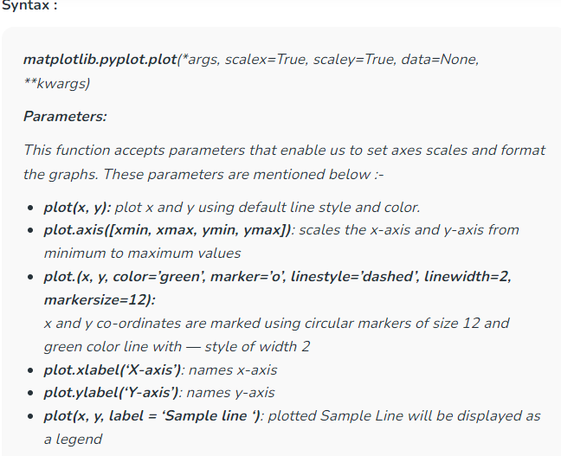

Slide 13
Plots in Matplotlib
Line plot : The line graph is one of charts which shows information as a series of the line. The graph is plotted by the plot() function. The line graph is simple to plot;
Bar graphs are one of the most common types of graphs and are used to show data associated with the categorical variables. Matplotlib provides a bar() to make bar graphs which accepts arguments such as: categorical variables, their value and color.
A pie chart is a circular graph that is broken down in the segment or slices of pie. It is generally used to represent the percentage or proportional data where each slice of pie represents a particular category. Let's have a look at the below example:
Histogram: First, we need to understand the difference between the bar graph and histogram. A histogram is used for the distribution, whereas a bar chart is used to compare different entities. A histogram is a type of bar plot that shows the frequency of a number of values compared to a set of values ranges.For example we take the data of the different age group of the people and plot a histogram with respect to the bin. Now, bin represents the range of values that are divided into series of intervals. Bins are generally created of the same size
Scatter plot: The scatter plots are mostly used for comparing variables when we need to define how much one variable is affected by another variable. The data is displayed as a collection of points. Each point has the value of one variable, which defines the position on the horizontal axes, and the value of other variable represents the position on the vertical axis.
Notes:
https://www.javatpoint.com/matplotlib

Slide 14
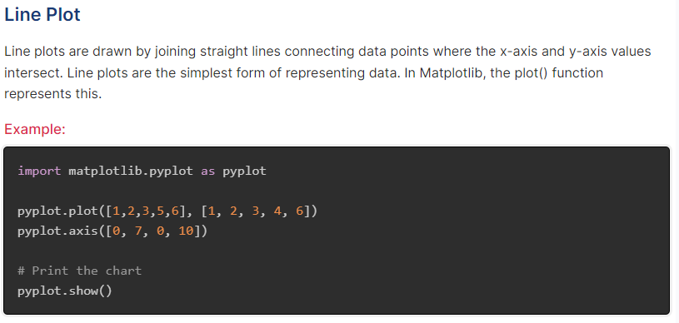
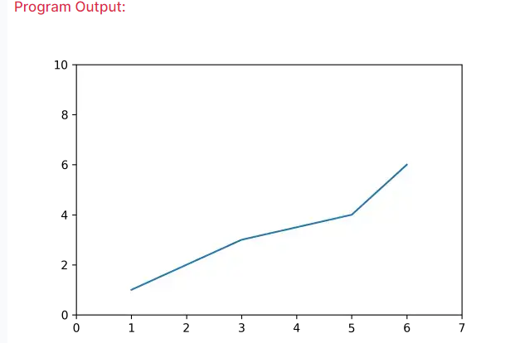

Slide 15
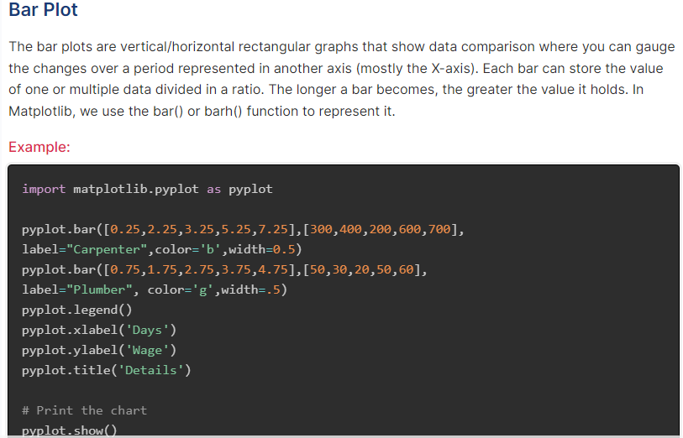
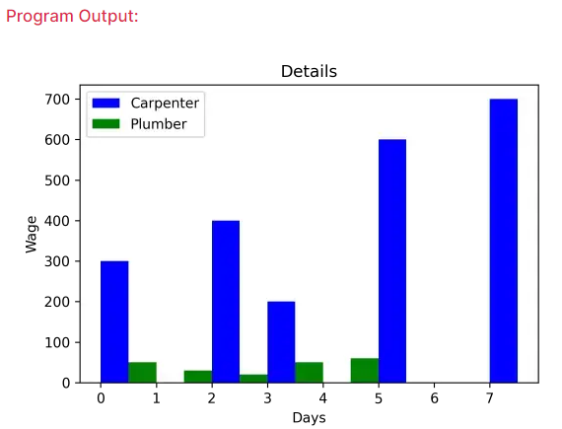

Slide 16
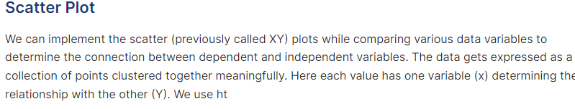
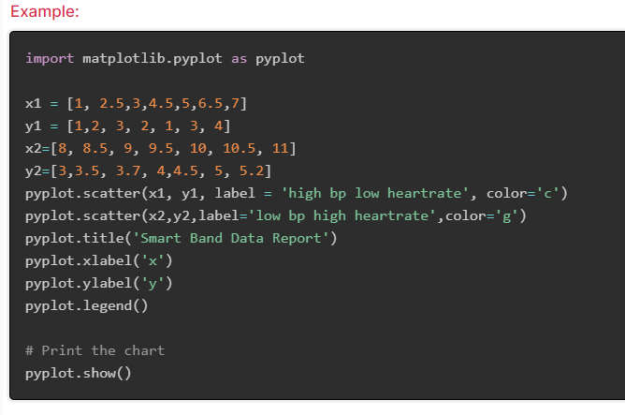
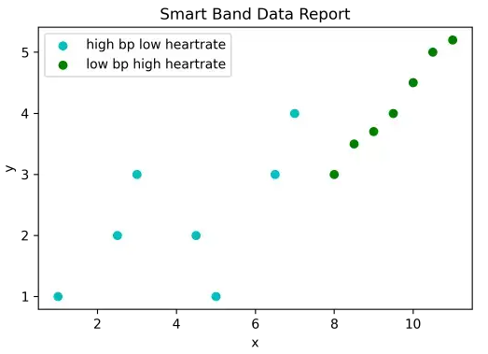

Slide 17
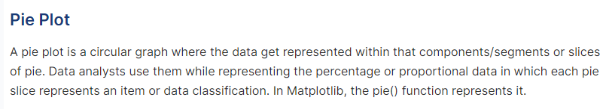
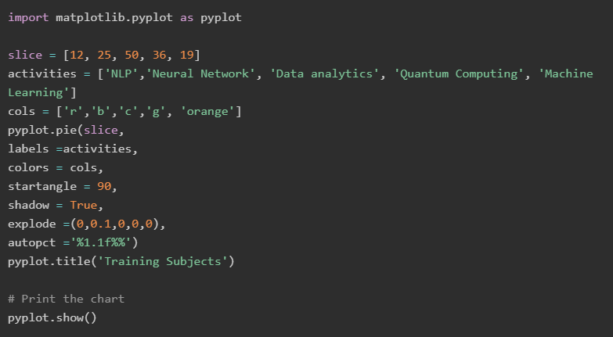
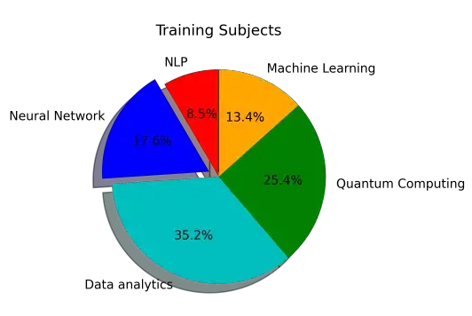

Slide 18
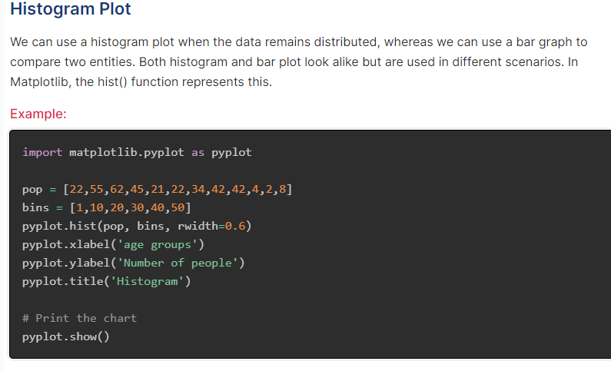
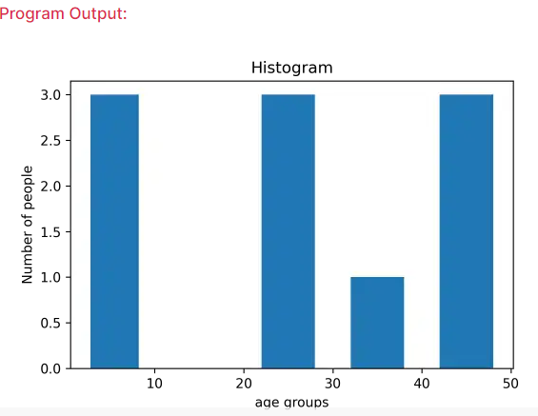

Slide 19
THANK YOU

